Slide 1

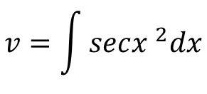
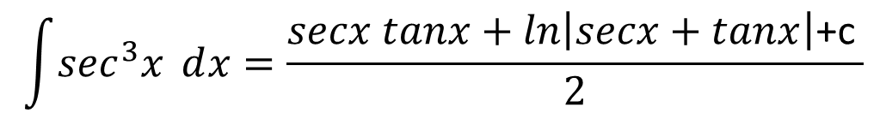

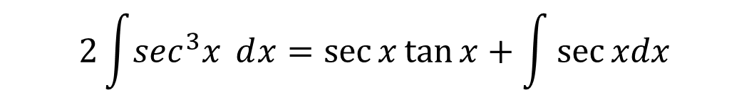
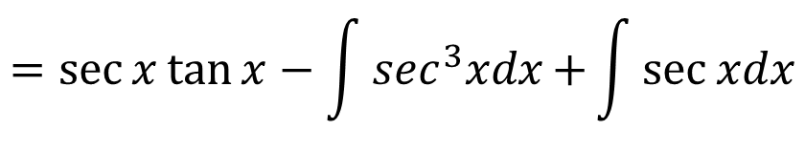
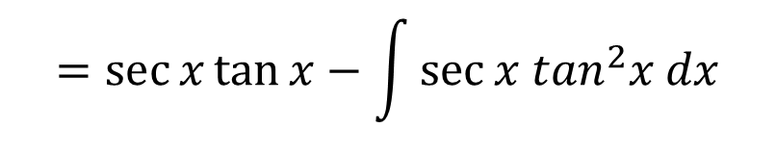
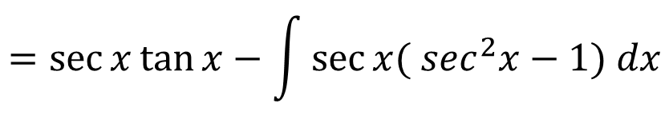
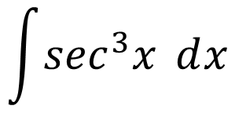


$$\int{udv=uv−\int{vdu}}$$
$$\int{\sec^{3}x ⅆx}$$
$$=\sec{x\tan{x}−\int{\sec{x \tan^{2}x dx}}}$$
$$=\sec{x\tan{x}−\int{\sec{x( \sec^{2}x−1) dx}}}$$
$$u=\sec{x dv=\sec^{2}x dx}$$
$$v=\int{sec{x }^{2}dx}$$
$$du=\sec{x tanx dx}$$
$$=\sec{x\tan{x}−\int{\sec^{3}xdx{+\int{\sec{xdx}}}}}$$
$$v=\tan{x}$$
$$2\int{\sec^{3}x ⅆx}=\sec{x\tan{x}+\int{\sec{xdx}}}$$
$$\int{\sec^{3}x ⅆx}=\frac{secx tanx+ln\left|secx+tanx\right|\text{+}\text{c} }{2}$$

Slide 2
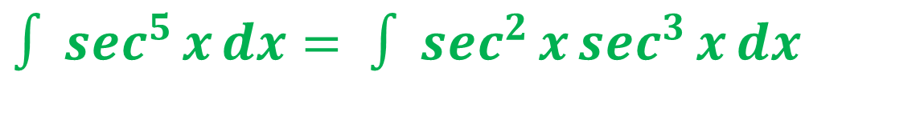

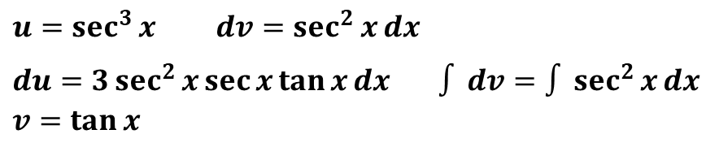
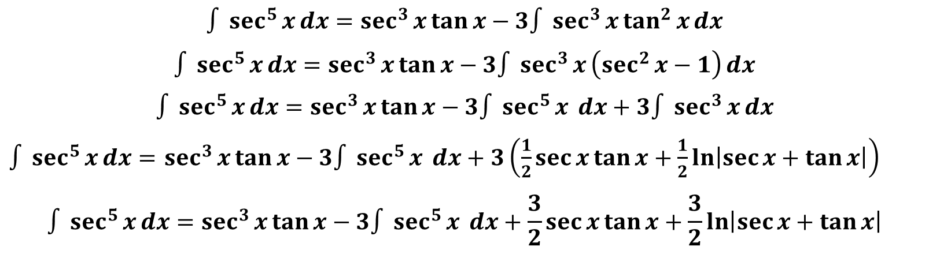
$∫\sec^{5}{x}ⅆx= ∫\sec^{2}{x}\sec^{3}{x}ⅆx$
$$\int{udv=uv−\int{vdu}}$$
$u=\sec^{3}{x} ⅆv=\sec^{2}{x}ⅆx$
$ⅆu=3\sec^{2}{x}\sec{x}\tan{x}ⅆx ∫ⅆv=∫\sec^{2}{x}ⅆx$ $v=\tan{x}$
$$∫\sec^{5}{x}ⅆx=\sec^{3}{x}\tan{x}−3∫\sec^{3}{x}\tan^{2}{x}ⅆx$$
$$∫\sec^{5}{x}ⅆx=\sec^{3}{x}\tan{x}−3∫\sec^{3}{x}\left(\sec^{2}{x}−1\right)ⅆx$$
$$∫\sec^{5}{x}ⅆx=\sec^{3}{x}\tan{x}−3∫\sec^{5}{x} ⅆx+3∫\sec^{3}{x}ⅆx$$
$∫\sec^{5}{x}ⅆx=$ $\sec^{3}{x}\tan{x}−3∫\sec^{5}{x} ⅆx+3\left(\frac{1}{2}\sec{x}\tan{x}+\frac{1}{2}\ln\left|\sec{x}+\tan{x}\right|\right)$
$$∫\sec^{5}{x}ⅆx=\sec^{3}{x}\tan{x}−3∫\sec^{5}{x} ⅆx+\frac{3}{2}\sec{x}\tan{x}+\frac{3}{2}\ln\left|\sec{x}+\tan{x}\right|$$

Slide 3

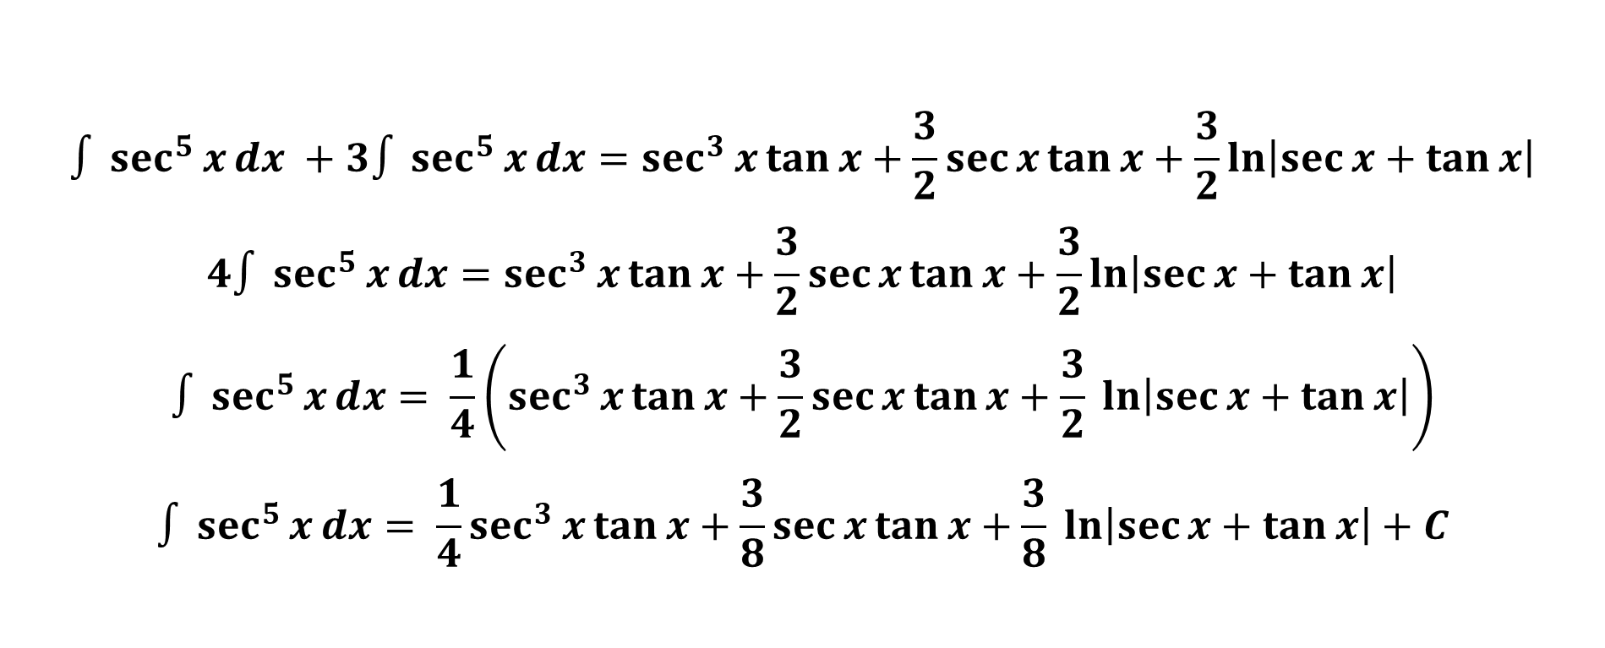
$$∫\sec^{5}{x}ⅆx +3∫\sec^{5}{x}ⅆx=\sec^{3}{x}\tan{x}+\frac{3}{2}\sec{x}\tan{x}+\frac{3}{2}\ln\left|\sec{x}+\tan{x}\right|$$
$$4∫\sec^{5}{x}ⅆx=\sec^{3}{x}\tan{x}+\frac{3}{2}\sec{x}\tan{x}+\frac{3}{2}\ln\left|\sec{x}+\tan{x}\right|$$
$$∫\sec^{5}{x}ⅆx= \frac{1}{4}\left(\sec^{3}{x}\tan{x}+\frac{3}{2}\sec{x}\tan{x}+\frac{3}{2}\ln\left|\sec{x}+\tan{x}\right|\right)$$
$$∫\sec^{5}{x}ⅆx= \frac{1}{4}\sec^{3}{x}\tan{x}+\frac{3}{8}\sec{x}\tan{x}+\frac{3}{8}\ln\left|\sec{x}+\tan{x}\right|+C$$

Slide 4

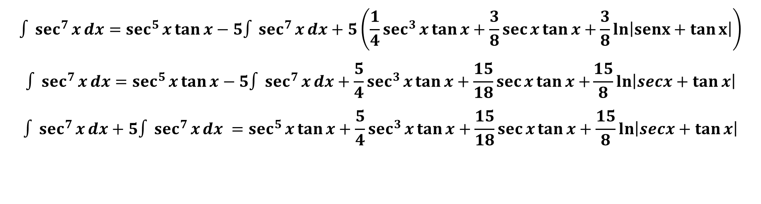
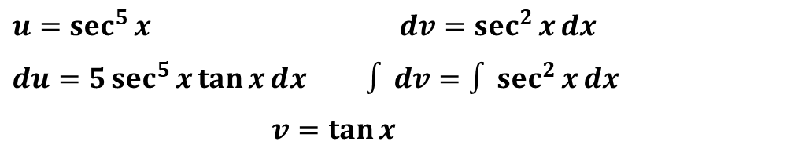
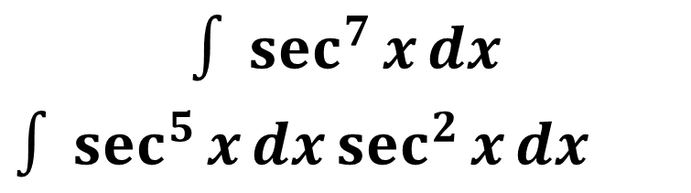
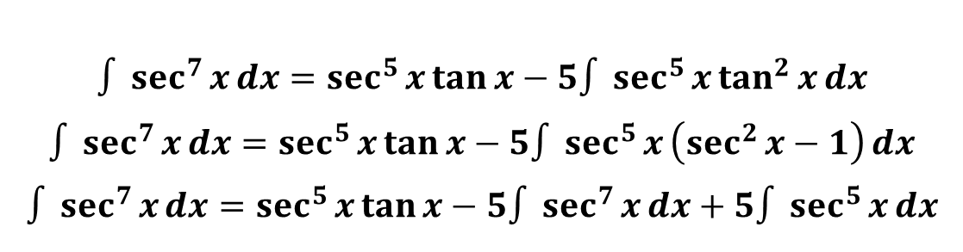
$$∫\sec^{7}{x}ⅆx$$
$∫\sec^{5}{x}ⅆx\sec^{2}{x}ⅆx$
$$\int{udv=uv−\int{vdu}}$$
$u=\sec^{5}{x} ⅆv=\sec^{2}{x}ⅆx$
$ⅆu=5\sec^{5}{x}\tan{x}ⅆx$ $∫ⅆv=∫\sec^{2}{x}ⅆx$
$v=\tan{x}$
$$∫\sec^{7}{x}ⅆx=\sec^{5}{x}\tan{x}−5∫\sec^{5}{x}\tan^{2}{x}ⅆx$$
$$∫\sec^{7}{x}ⅆx=\sec^{5}{x}\tan{x}−5∫\sec^{5}{x}\left(\sec^{2}{x}−1\right)ⅆx$$
$$∫\sec^{7}{x}ⅆx=\sec^{5}{x}\tan{x}−5∫\sec^{7}{x}ⅆx+5∫\sec^{5}{x}ⅆx$$
$$∫\sec^{7}{x}ⅆx=\sec^{5}{x}\tan{x}−5∫\sec^{7}{x}ⅆx+5\left(\frac{1}{4}\sec^{3}{x}\tan{x}+\frac{3}{8}\sec{x}\tan{x}+\frac{3}{8}ln\left|sⅇnx+\tan{x}\right|\right)$$
$$∫\sec^{7}{x}ⅆx=\sec^{5}{x}\tan{x}−5∫\sec^{7}{x}ⅆx+\frac{5}{4}\sec^{3}{x}\tan{x}+\frac{15}{18}\sec{x}\tan{x+}\frac{15}{8}\ln\left|sⅇcx+\tan{x}\right|$$
$$∫\sec^{7}{x}ⅆx+5∫\sec^{7}{x}ⅆx =\sec^{5}{x}\tan{x}+\frac{5}{4}\sec^{3}{x}\tan{x}+\frac{15}{18}\sec{x}\tan{x}+\frac{15}{8}\ln\left|sⅇcx+\tan{x}\right|$$

Slide 5
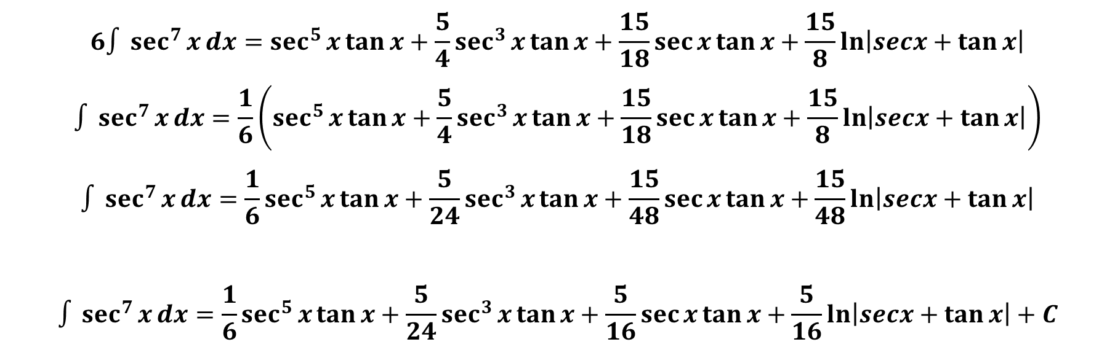
$$6∫\sec^{7}{x}ⅆx=\sec^{5}{x}\tan{x}+\frac{5}{4}\sec^{3}{x}\tan{x}+\frac{15}{18}\sec{x}\tan{x}+\frac{15}{8}\ln\left|sⅇcx+\tan{x}\right|$$
$$∫\sec^{7}{x}ⅆx=\frac{1}{6}\left(\sec^{5}{x}\tan{x}+\frac{5}{4}\sec^{3}{x}\tan{x}+\frac{15}{18}\sec{x}\tan{x}+\frac{15}{8}\ln\left|sⅇcx+\tan{x}\right|\right)$$
$$∫\sec^{7}{x}ⅆx=\frac{1}{6}\sec^{5}{x}\tan{x}+\frac{5}{24}\sec^{3}{x}\tan{x}+\frac{15}{48}\sec{x}\tan{x}+\frac{15}{48}\ln\left|sⅇcx+\tan{x}\right|$$
$$∫\sec^{7}{x}ⅆx=\frac{1}{6}\sec^{5}{x}\tan{x}+\frac{5}{24}\sec^{3}{x}\tan{x}+\frac{5}{16}\sec{x}\tan{x}+\frac{5}{16}\ln\left|sⅇcx+\tan{x}\right|+C$$

